Slide 1

IT MALAYSIA TOWNHALL
OCTOBER 2026

Slide 2

agenda
01 | IT Malaysia Updates Riadh Gasmi
02 | Production Support KPI Kunalan Sudhagaran
03 | AI for Production Support Intelligence (APSI) Fakhri Yahaya
04 | New Joiners Introduction
05 | CACEIS API GATEWAY - Tech Ecosystems Solutions Samantha Dharmarathna
06 | Atlassian Administration Mervyn Toh
07 | FDS Pulse (Nova) Muhammad Nabil, Nadir Chowdhury, Azli Che Ni, Bayes Shoharto
08 | Q&A

Slide 3

01
IT Malaysia Updates
Riadh Gasmi

Slide 4
Write the title of your slide here
It MALAYSIA uPDATES
This is your first level of text
  This is your second level of text
    This is your third level of text
      This is your fourth level of text
        This is your fifth level of text

Slide 5

02
Production support kpi
Gary Siu

Slide 6
Write the title of your slide here
PRODUCTION SUPPORT KPI
3D-stats on KL IT performance + Prevention of major incident impacting EU Start of Day (SOD)
1
2
50
37
Prevention of major incident impacting EU Start of Day (SOD)
3

Slide 7

03
AI for Production Support Intelligence (APSI)
Fakhri Yahaya

Slide 8
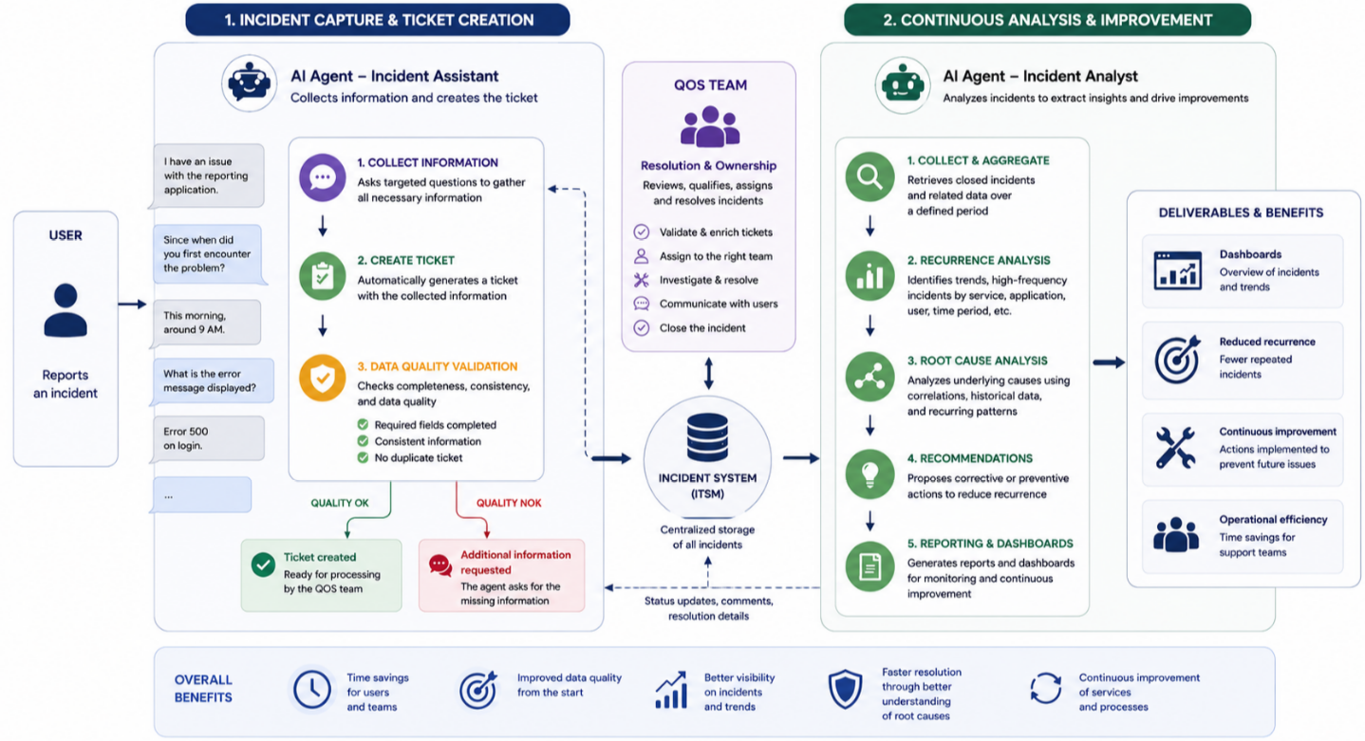
Write the title of your slide here
AI for Production Support Intelligence (APSI)

Slide 9
04
New joinerS introduction

Slide 10
New joiners October 2026
Bhavani Seetharaman
Quality of Service (QoS)
Production Support
Jonathan Kiew
IT Innovation
AI Python Developer
Amos Tertese
Market Solutions
Java Developer

Slide 11
05
CACEIS API GATEWAY - Tech Ecosystems Solutions
Samantha Dharmarathna

Slide 12
Skill & Tasks
CORE SKILLS
Java/ J2EE
DB (Oracle, SQL Server, MY SQL, Dynamo DB)
React
React Native
Crystal Report/ Jasper Report
AWS
CI/CD
System Analysis and Design
Software Architecture
TASKS PERFORMED
Implement Webhook monitoring dashboard
Onboard new APIs
Fixing technical issues related to APIs

Slide 13
CACEIS API Gateway
It is an API manager based on WSO2 APIM and IDP product.
The API Manager is designed to expose and secure business APIs, enabling clients and partners to access services through a secure and highly available infrastructure.
1. Client credentials grant type/ Authorization code grant type
2. API level policies
  Rate limiting
  Response caching. Reduced backend queries
  Schema Validation - Enable the request and response validation against the OpenAPI definition
  Backend Throughput - Limits the total number of calls the API Manager is allowed to make to the backend
  3. Configure Alerts
4. CORS configuration

Slide 14
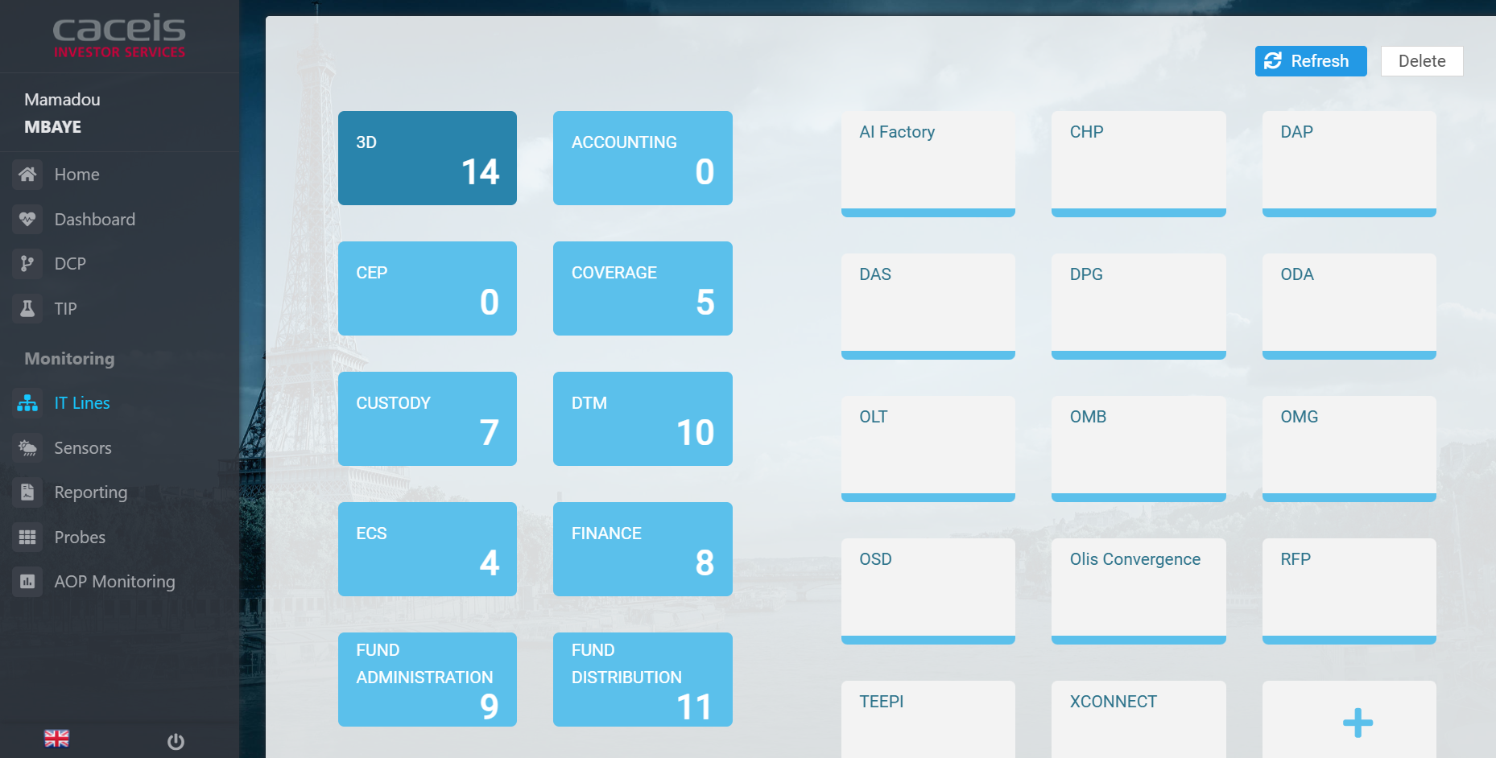
Applications
RTM – IT Lines
RTM is an internal system developed by TAI team. It is used to monitor the status of the services.

Slide 15
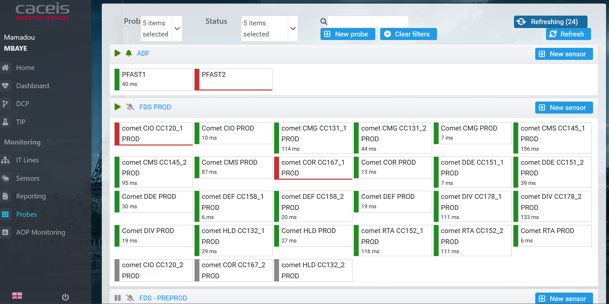
Applications
RTM - Probes

Slide 16
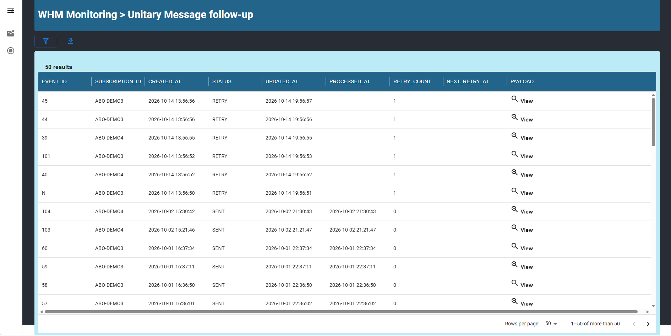
Applications
WHM Monitoring

Slide 17
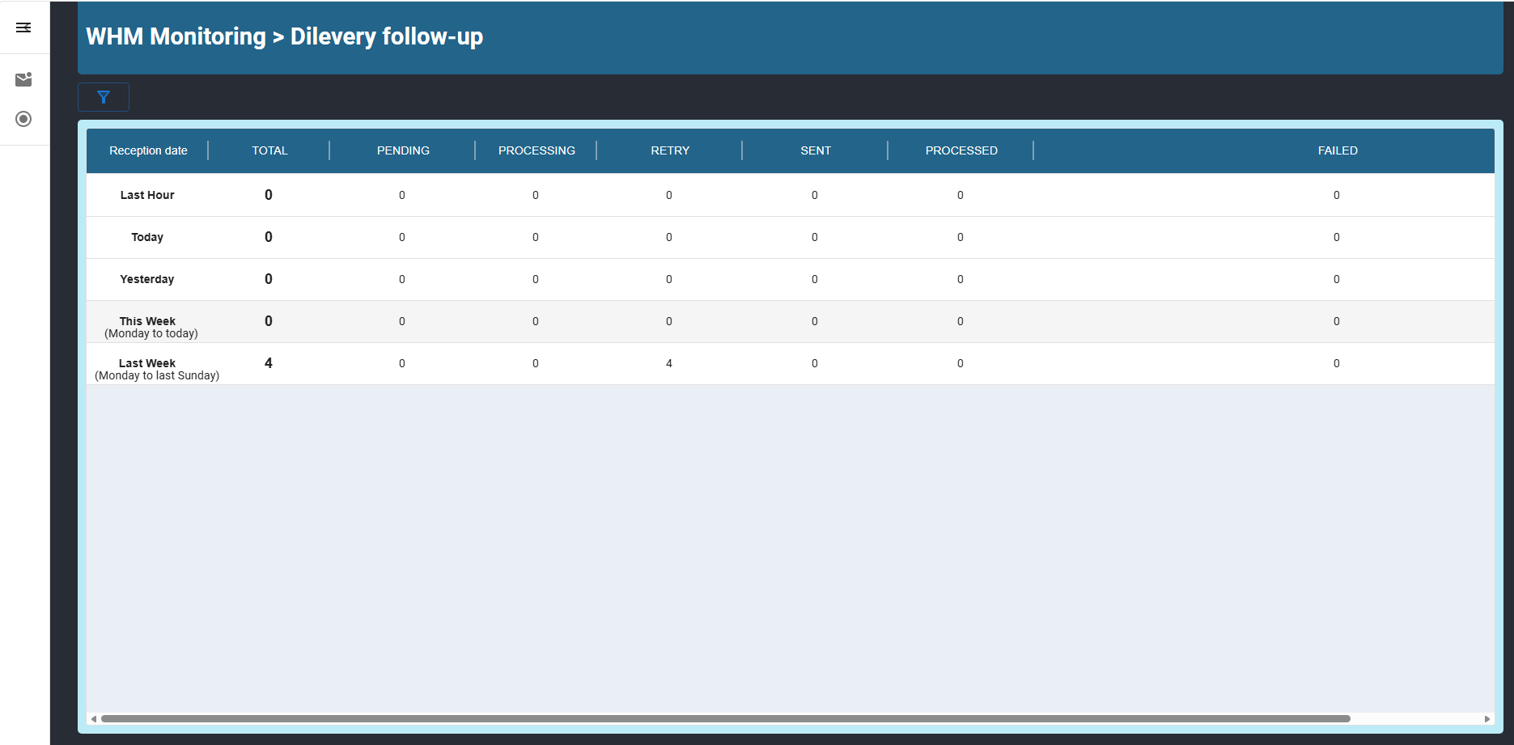
Applications
WHM Monitoring

Slide 18
Onboarding New APIs
Prepare – Prepare the necessary API details, documentation, and backend configurations.
Fill the Form - Complete the integration form provided by the API Manager team with all relevant API details.
Send Swaggers - Submit the Swagger definitions (YAML or JSON files) for the API
Check Definition and Swagger (TAI) - Validate the provided definitions and ensure the Swagger files meet the required standards.
Open Flows (TAI) - Configure and test the API workflows in the Test Acceptance Infrastructure (TAI).
Deploy And Publish API (TAI) - Deploy the API in the TAI PRE-PRODCUTION environment for further testing and evaluation.

Slide 19
06
Atlassian Administration
Mervyn Toh

Slide 20
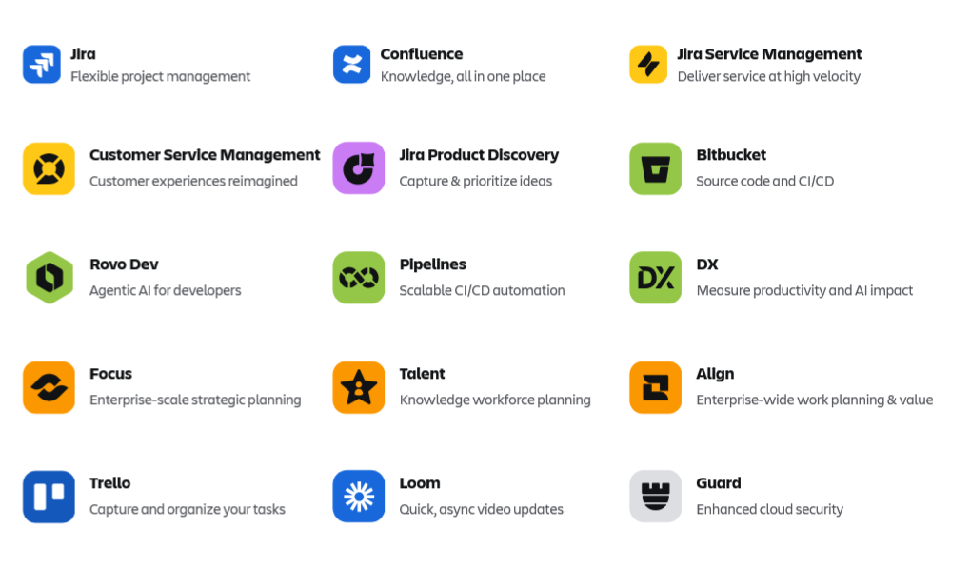
Atlassian Application Administration Team
Members of Team :
Michael Mroz
Robert Philippe
Valerio Passarinho
Jose Carvalho
Mervyn Toh

Slide 21
Atlassian Application Administration Team – Responsibilities & Contacts
        Team Responsibilities:
        Application and process governance (administration, optimization)
        Application migration from existing data center platform to cloud (Atlassian) platform
        Personal Responsibilities:
        Best practices and consultation to the Atlassian team and the wider organization
        Application adoption and training
        Application administration and support for Malaysia
        Contact:
        jira_support@caceis.com
        confluence_support@caceis.com
        Create an issue/ticket in the Jira project or Confluence project in JiraH ( jirah.olisnet.com )

Slide 22
07
FDS Pulse (Nova)
Muhammad Nabil, Nadir Chowdhury, Azli Che Ni, Bayes Shoharto

Slide 23
AGENDA
PULSE NOVA – OVERVIEW
TEAM STRUCTURE
TECHNOLOGY STACK – OVERVIEW
SHORT DEMO
KEY ACHIEVEMENTS
TEAM BONDING
Q&A

Slide 24
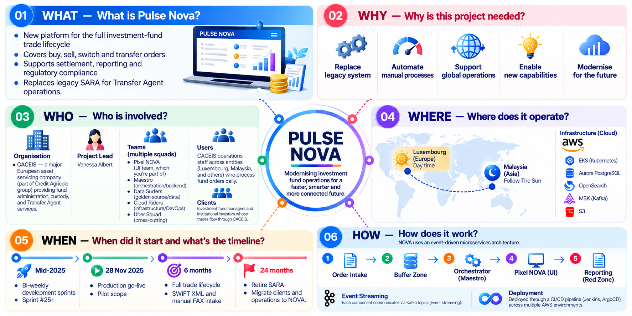
PULSE NOVA - OVERVIEW
Notes:
Pulse Nova: Modernising investment fund operations for a faster, smarter and more connected future
01. WHAT: What is Pulse Nova?
A new platform that covers the full investment-fund trade lifecycle
Handles buy, sell, switch and transfer orders
Supports settlement, reporting and regulatory compliance
Replaces the legacy SARA system for Transfer Agent operations
02. WHY: Why do we need it?
Replace the legacy system
Automate manual processes
Support global operations
Enable new capabilities
Modernise for the future
03. WHO: Who is involved?
Organisation: CACEIS (part of Crédit Agricole group), which provides fund administration, custody and Transfer Agent services
Project Lead: Vanessa Albert
Squads:
Pixel NOVA: UI
Maestro: orchestration and backend
Data Surfers: golden source and data
Cloud Riders: infrastructure and DevOps
Uber Squad: cross-cutting work
Users: CACEIS operations staff in Luxembourg, Malaysia and other locations
Clients: Investment fund managers and institutional investors
04. WHERE: Where does it operate?
Luxembourg (Europe) covers day time and Malaysia (Asia) covers follow-the-sun
Runs on AWS: EKS (Kubernetes), Aurora PostgreSQL, OpenSearch, MSK (Kafka) and S3
05. WHEN: What's the timeline?
Mid-2025: Development started, with bi-weekly sprints (now past Sprint #25)
28 Nov 2025: Production go-live with a pilot scope
+6 months: Full trade lifecycle, plus SWIFT XML and manual FAX intake
+24 months: Retire SARA and move all clients and operations to NOVA
06. HOW: How does it work?
Built on an event-driven microservices architecture
Flow: Order Intake → Buffer Zone → Orchestrator (Maestro) → Pixel NOVA (UI) → Reporting (Red Zone)
Event streaming: Components talk to each other through Kafka topics
Deployment: A CI/CD pipeline (Jenkins, ArgoCD) deploys across multiple AWS environments

Slide 25
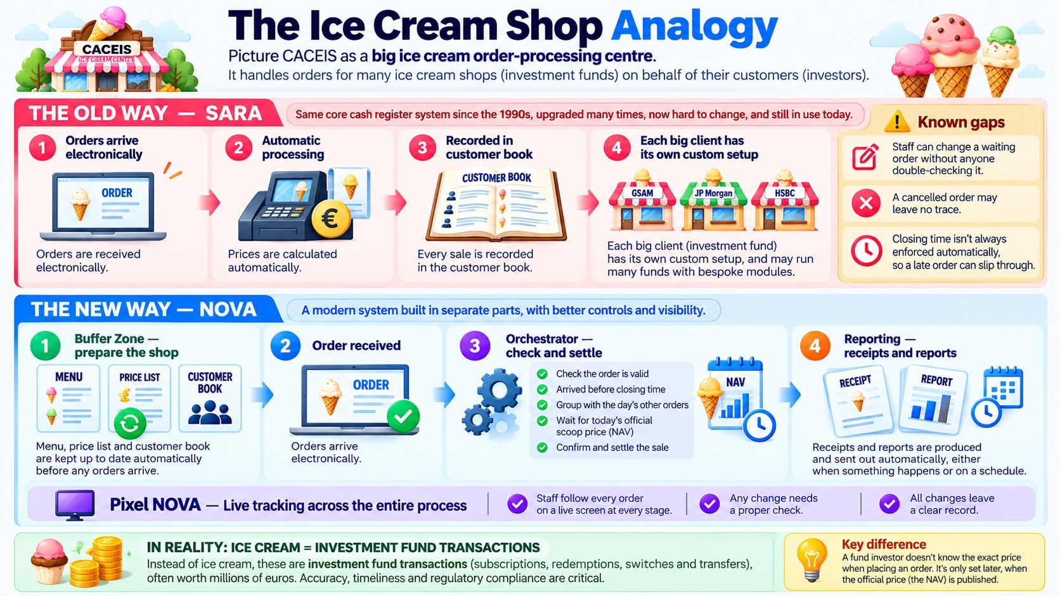
PULSE NOVA - OVERVIEW
Notes:
The Ice Cream Shop Analogy
Think of CACEIS as a large ice cream order-processing centre
It processes orders for many ice cream shops (investment funds) on behalf of their customers (investors)
The Old Way: SARA
The same core "cash register" system has been in use since the 1990s. It has been upgraded many times and is now hard to change.
How it works:
Orders arrive electronically
Prices are calculated automatically
Every sale is recorded in the customer book
Each big client (e.g. GSAM, JP Morgan, HSBC) has its own custom setup, often with bespoke modules
Known gaps:
Staff can change a waiting order without anyone double-checking it
A cancelled order may leave no trace
Closing time isn't always enforced, so a late order can slip through
The New Way: NOVA
A modern system built in separate parts, with better controls and visibility
How it works:
Buffer Zone (prepare the shop): The menu, price list and customer book are kept up to date automatically before any orders arrive
Order received: Orders arrive electronically
Orchestrator (check and settle):
Checks that the order is valid
Checks that it arrived before closing time
Groups it with the day's other orders
Waits for today's official scoop price (NAV)
Confirms and settles the sale
Reporting: Receipts and reports are sent out automatically, either when something happens or on a schedule
Pixel NOVA (live tracking across the whole process):
Staff can follow every order on a live screen at every stage
Any change needs a proper check
All changes leave a clear record
In Reality: Ice Cream = Investment Fund Transactions
The "ice cream" stands for subscriptions, redemptions, switches and transfers
These transactions are often worth millions of euros
Accuracy, timeliness and regulatory compliance are critical
Key Difference
A fund investor doesn't know the exact price when placing an order
The price is set later, when the official NAV is published

Slide 26
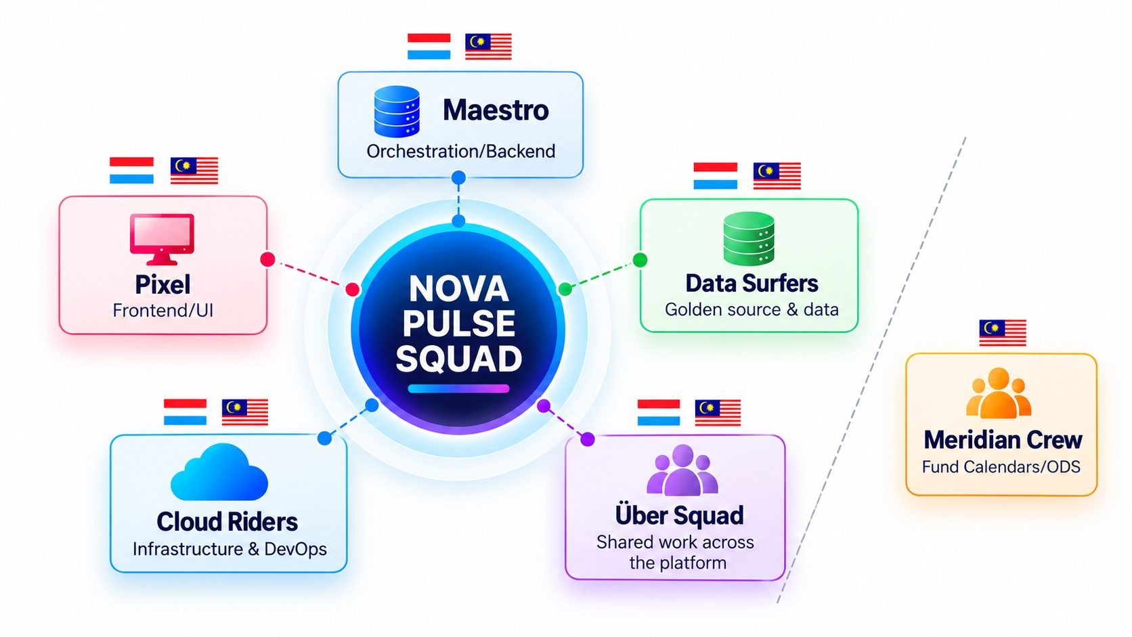
TEAM STRUCTURE
FSD: Bayes Ahmed
FSD: Mohd Azli
QA: Muhammad Nabil
FSD: Bayes Ahmed
FSD: Mohd Azli
FSD: Nadir Munir
QA: Muhammad Nabil
Notes:
Team Structure: NOVA Pulse Squad
One central squad, NOVA Pulse, made up of five specialised sub-teams
Each sub-team has members in both Luxembourg and Malaysia
Sub-teams
Maestro: Orchestration and backend
FSD: Bayes Ahmed
Pixel: Frontend and UI
FSD: Mohd Azli
QA: Muhammad Nabil
Data Surfers: Golden source and data
Cloud Riders: Infrastructure and DevOps
Über Squad: Shared work across the platform
Meridian Crew: Fund Calendars and ODS
A separate team that focuses on fund calendars and ODS
Based in Malaysia
Members:
FSD: Bayes Ahmed
FSD: Mohd Azli
FSD: Nadir Munir
QA: Muhammad Nabil
Key Takeaway
The work is split by area (UI, backend, data, infrastructure and shared work), with teams in two locations
Some team members, such as Bayes Ahmed, Mohd Azli and Muhammad Nabil, work in both the core squads and Meridian Crew

Slide 27
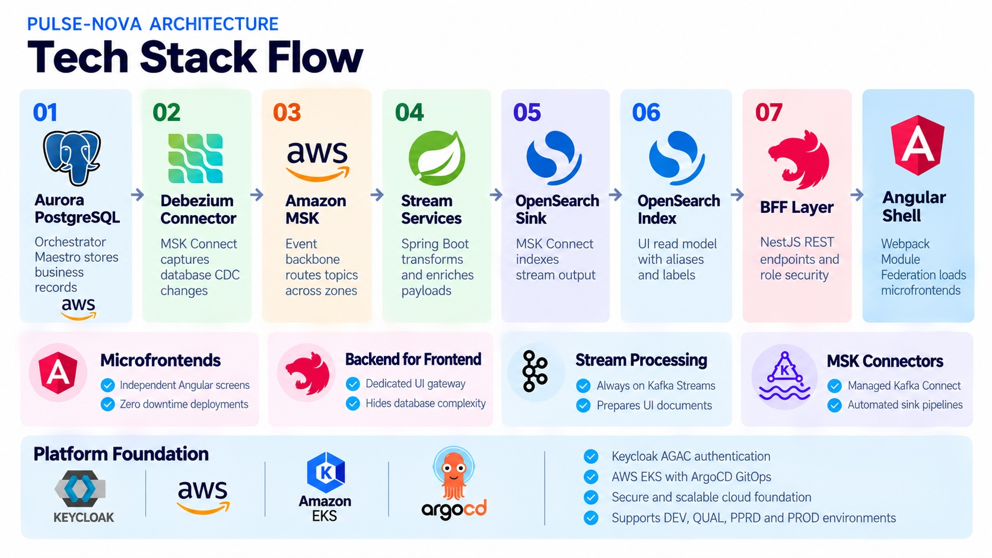
TECHNOLOGY STACK - OVERVIEW
Notes:
Pulse-NOVA Architecture: Tech Stack Flow
Data moves step by step from the database through to the user's screen
The Data Flow (Steps 01–07 + UI)
Aurora PostgreSQL: The Orchestrator (Maestro) stores business records here, on AWS
Debezium Connector: MSK Connect captures database changes (CDC)
Amazon MSK: The event backbone, which routes Kafka topics across zones
Stream Services: Spring Boot services transform and enrich the data
OpenSearch Sink: MSK Connect writes the processed stream into OpenSearch
OpenSearch Index: The UI's read model, with aliases and labels
BFF Layer: NestJS REST endpoints with role-based security
Angular Shell: Uses Webpack Module Federation to load the microfrontends
Key Building Blocks
Microfrontends (Angular):
Each screen is a separate Angular app
Screens can be deployed with zero downtime
Backend for Frontend (NestJS):
A dedicated gateway for the UI
Keeps database complexity away from the frontend
Stream Processing (Kafka Streams):
Runs continuously
Prepares documents ready for the UI
MSK Connectors:
Managed Kafka Connect
Sink pipelines run automatically
Platform Foundation
Keycloak: Handles authentication (the slide says "AGAC")
AWS EKS with ArgoCD: Deployments are managed through GitOps
A secure, scalable cloud foundation
Supports four environments: DEV, QUAL, PPRD and PROD
Key Takeaway
When a record changes in the database, the change streams through Kafka, gets indexed in OpenSearch, and shows up in the UI through the BFF. Data reaches users quickly and the frontend stays separate from the database.

Slide 29
SHORT DEMO

Slide 30
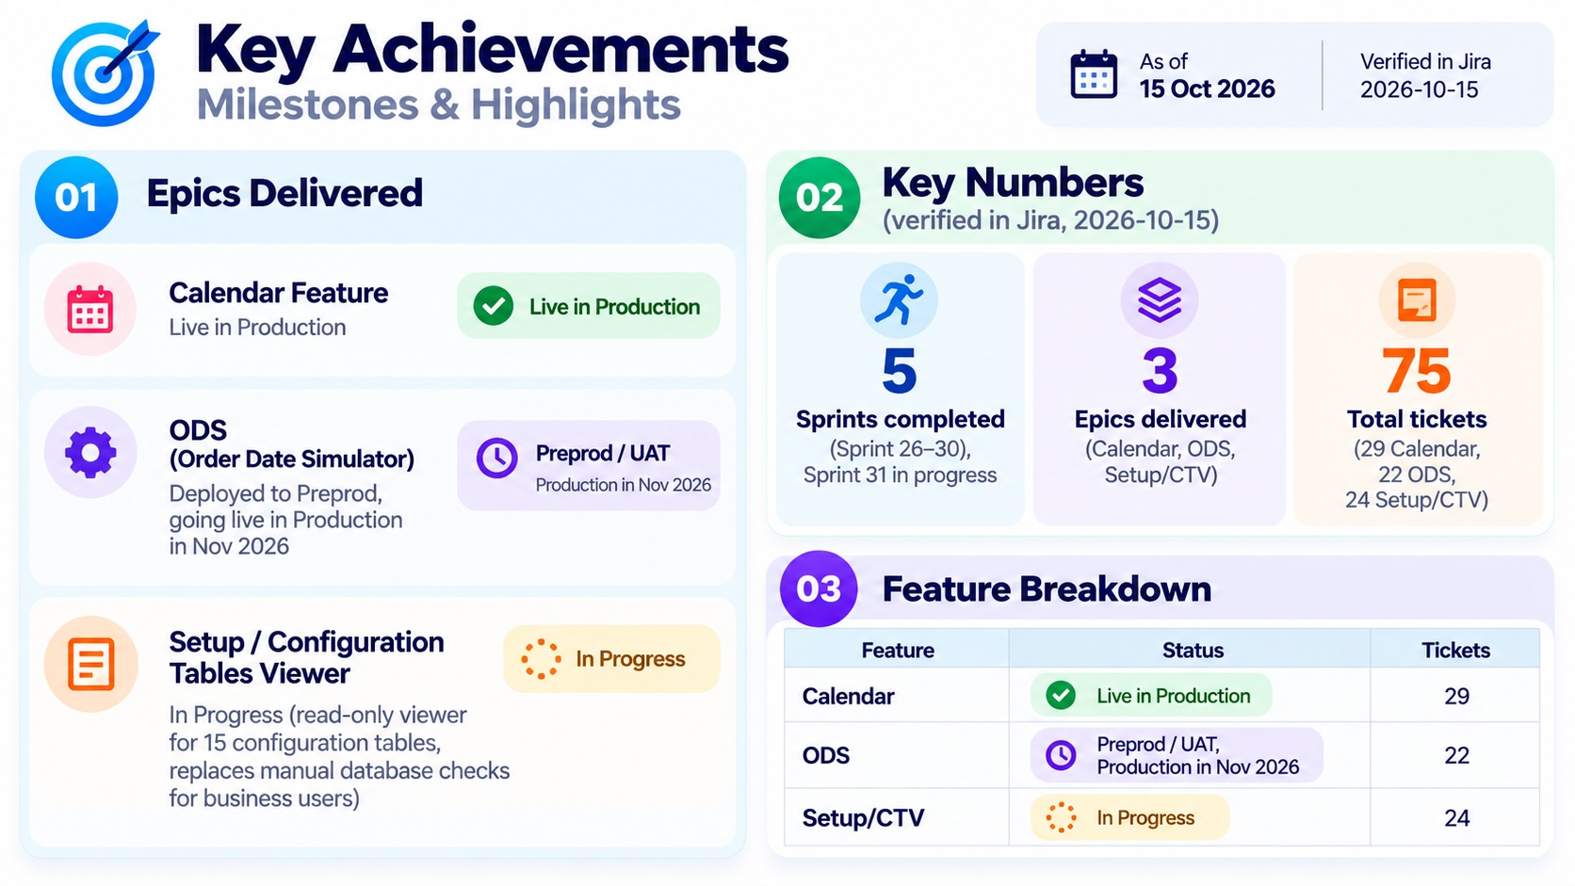
KEY ACHIEVEMENTS
Notes:
Key Achievements: Milestones & Highlights
Status as of 15 Oct 2026 (checked in Jira on 2026-10-15)
01. Epics Delivered
Calendar Feature: Live in Production
ODS (Order Date Simulator):
Deployed to Preprod and in UAT now
Production go-live planned for Nov 2026
Setup / Configuration Tables Viewer (CTV): In Progress
A read-only viewer for 15 configuration tables
Business users won't need manual database checks any more
02. Key Numbers
5 sprints completed: Sprints 26–30, with Sprint 31 in progress
3 epics delivered: Calendar, ODS and Setup/CTV
75 total tickets: 29 Calendar, 22 ODS and 24 Setup/CTV
03. Feature Breakdown
Feature
Status
Tickets
Calendar
Live in Production
29
ODS
Preprod / UAT, Production in Nov 2026
22
Setup/CTV
In Progress
24
Key Takeaway
One feature is live, one is close to Production, and one is in progress. The team closed 75 tickets over 5 sprints.

Slide 31
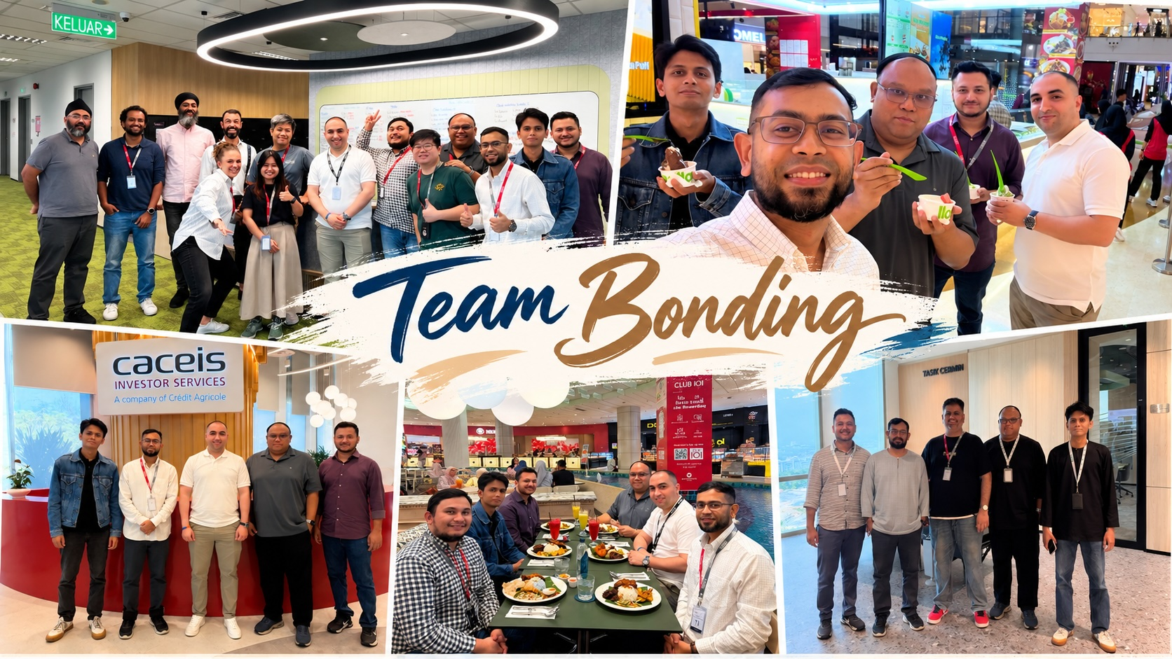
TEAM BONDINGS

Slide 32


Q&A

Slide 33

Thank you

